Slide 1

BULMA CSS

Slide 2

Our Discovery of Bulma
01
02
Introduction to Bulma
Installation
03
04
Main Advantages
BEM System
05
06
Colors & Utilities
Demonstration

Slide 3
INTRODUCTION TO BULMA

Slide 4

Bulma's Advantages
Pure CSS
No JavaScript dependencies, you keep full control over interactivity
Based on Flexbox
Modern architecture for fluid and responsive layouts
Modular
Import only the components you need
Responsive by default
Mobile-first with smart breakpoints

Slide 5




Bulma Installation
Several simple methods to start using Bulma in your projects. Choose the one that best fits your development workflow.
Via CDN
Via npm/yarn
Direct Download
The fastest solution to get started
For professional projects
From the official bulma.io website
npm install bulmayarn add bulma
<link rel="stylesheet" href="https://cdn.jsdelivr.net/npm/bulma@0.9.4/css/bulma.min.css">
💡 For full customization, use npm and import Bulma's Sass files into your project.

Slide 6


Why Choose Bulma?
Excellent Documentation
Active Community
Easy Customization

Slide 7
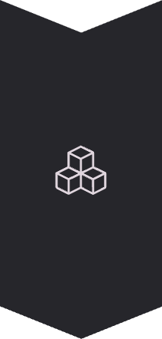
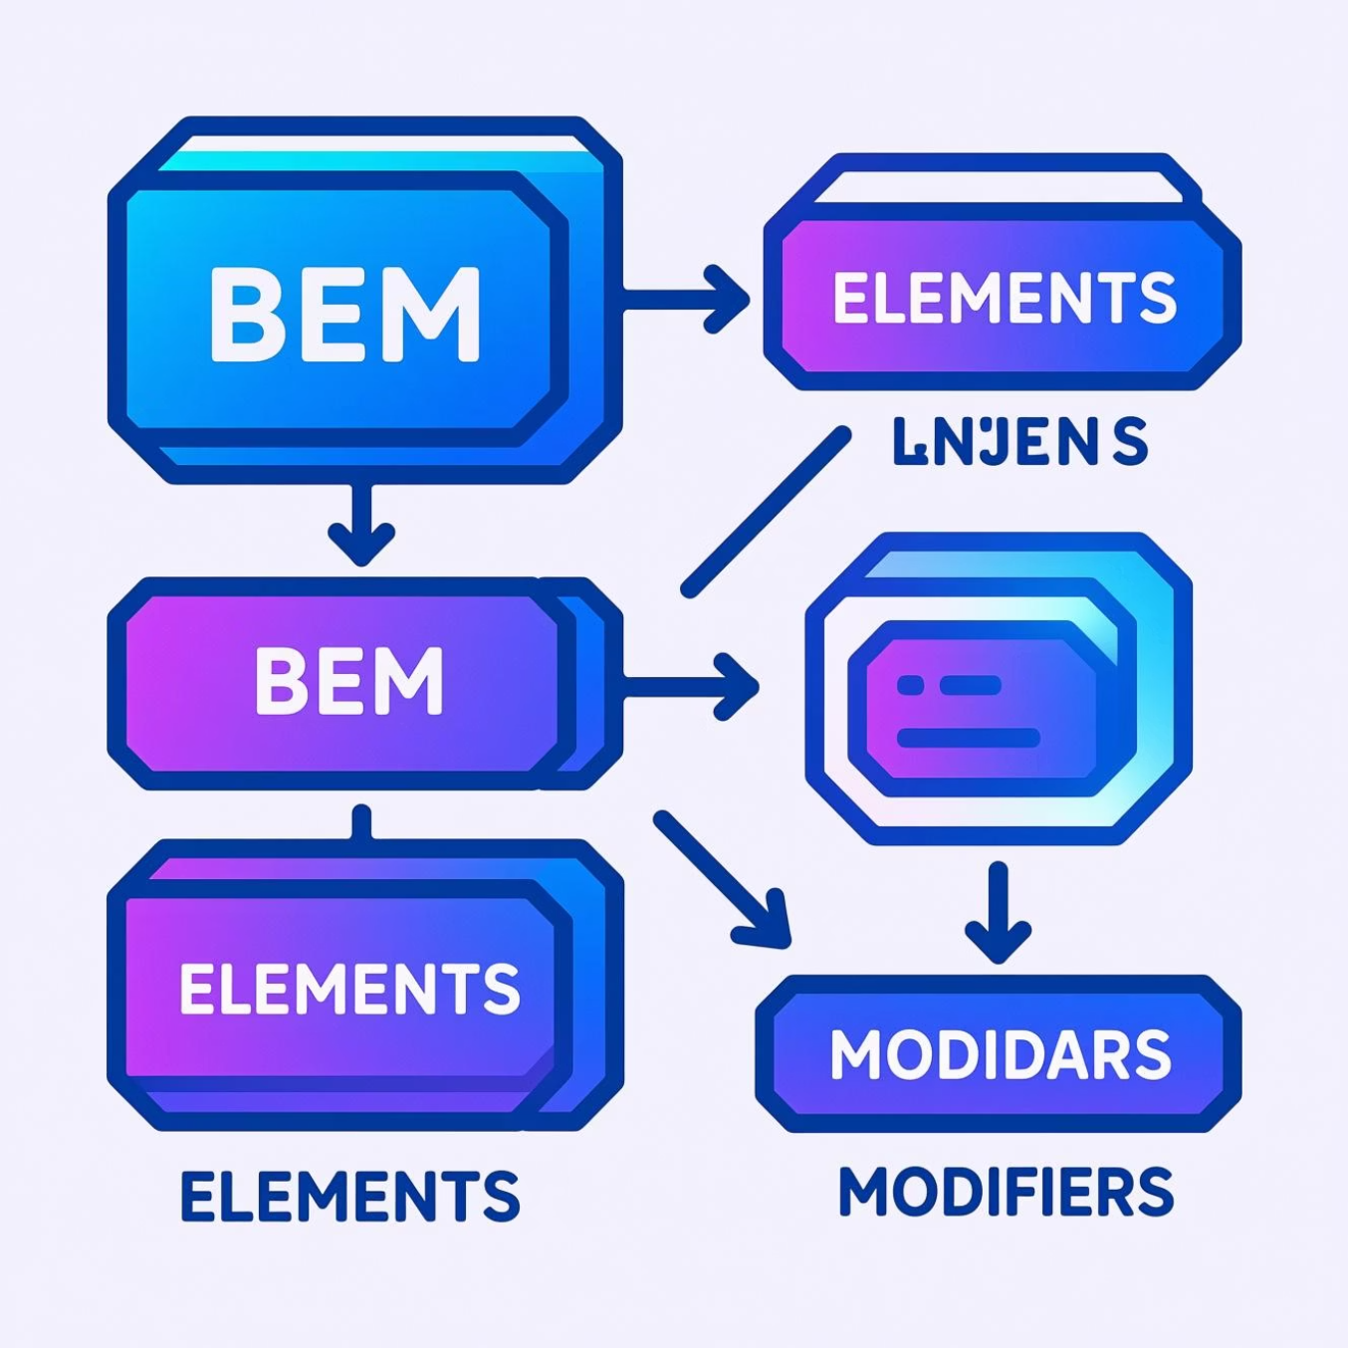


The BEM System
Block Element Modifier
Block
The main standalone component
.button
Element
A part of the block
.button__icon
Modifier
A variation of the block or element
.button--primary.button--large
Advantages: More readable code, simplified maintenance, avoids name conflicts, and allows optimal scalability for large projects,

Slide 8

The Color System
Bulma offers a semantic and consistent color palette, perfect for creating intuitive and professional interfaces.
Primary
Link
Success
.is-primary
.is-link
.is-success
Primary color: turquoise #00d1b2
For links and actions
Positive confirmations
Warning
Danger
.is-warning
.is-danger
Warnings
Errors and deletions
🎨 Easily personalize these colors via Sass variables to adapt Bulma to your graphic charter: $primary: #your-color

Slide 9
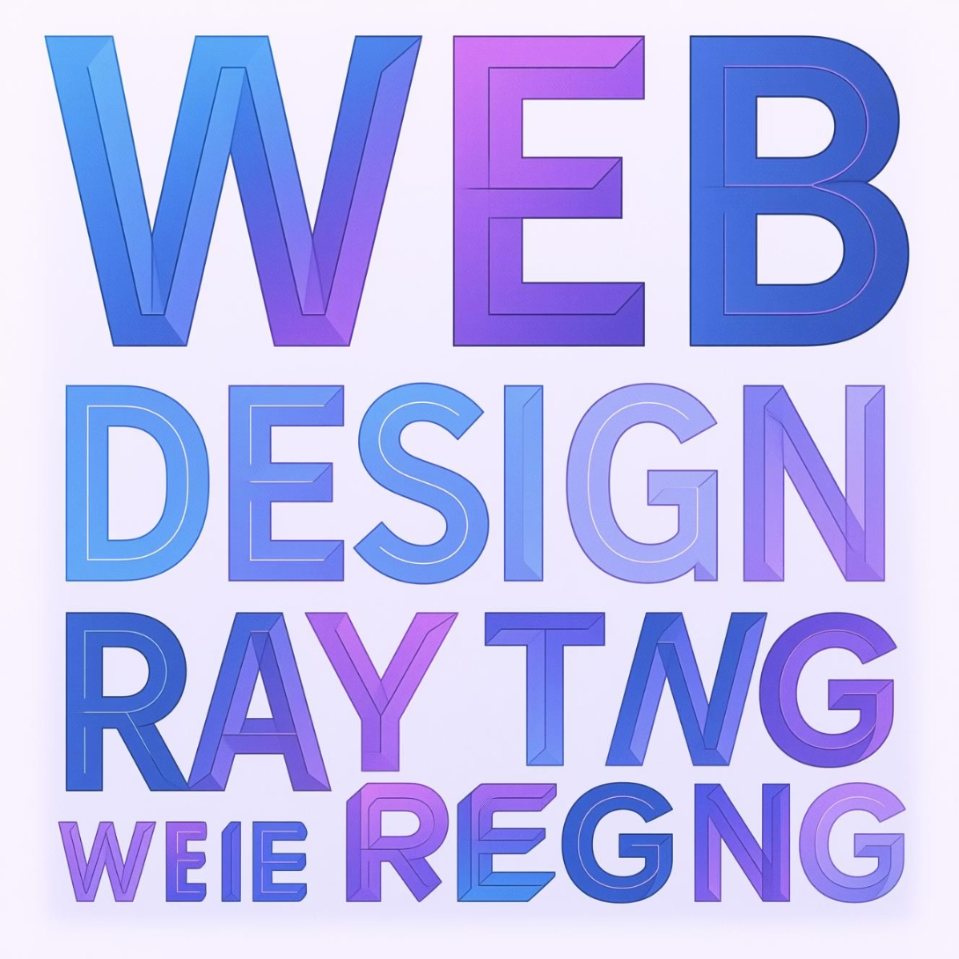
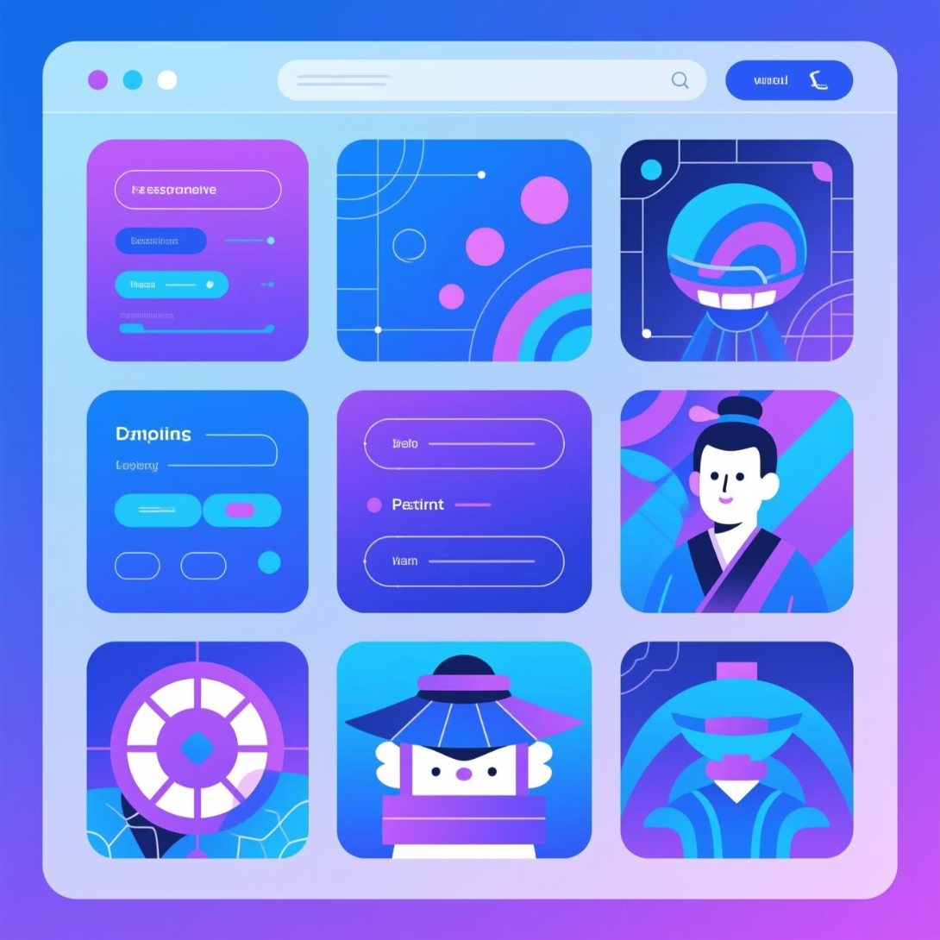
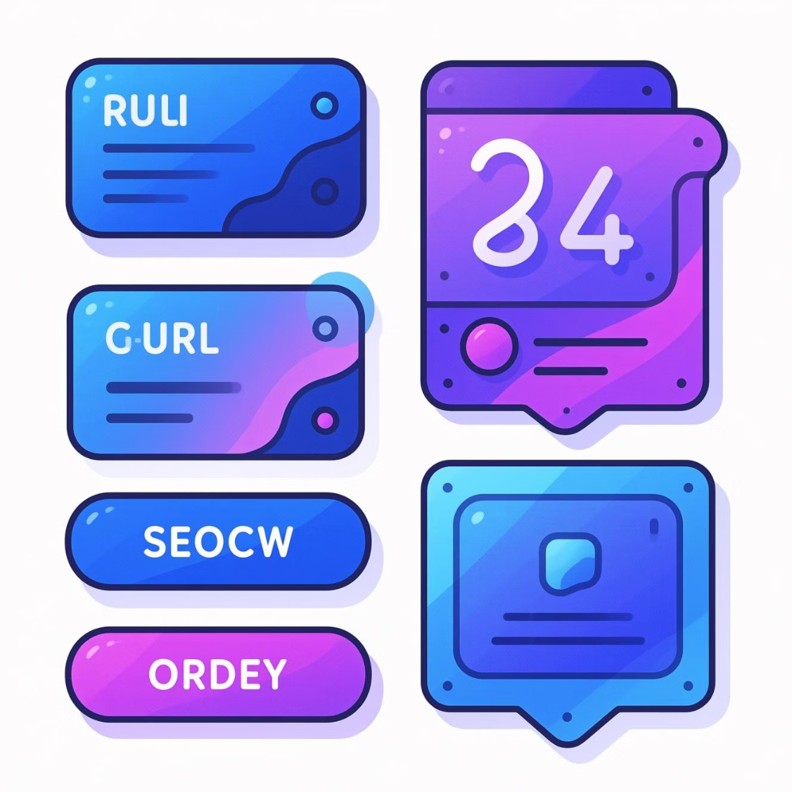
Essential Utility Classes
Typography
Layout
Components
.title et .subtitle
.container pour centrer
.navbar pour navigation
.is-size-1 à .is-size-7
.section pour espacer
.card pour contenus
.has-text-centered
.hero pour bannières
.modal pour popups
.has-text-weight-bold
.columns pour grilles
.notification pour alertes
Responsive: All classes can be suffixed with -mobile, -tablet, or -desktop for precise control over each breakpoint.
.

Slide 10
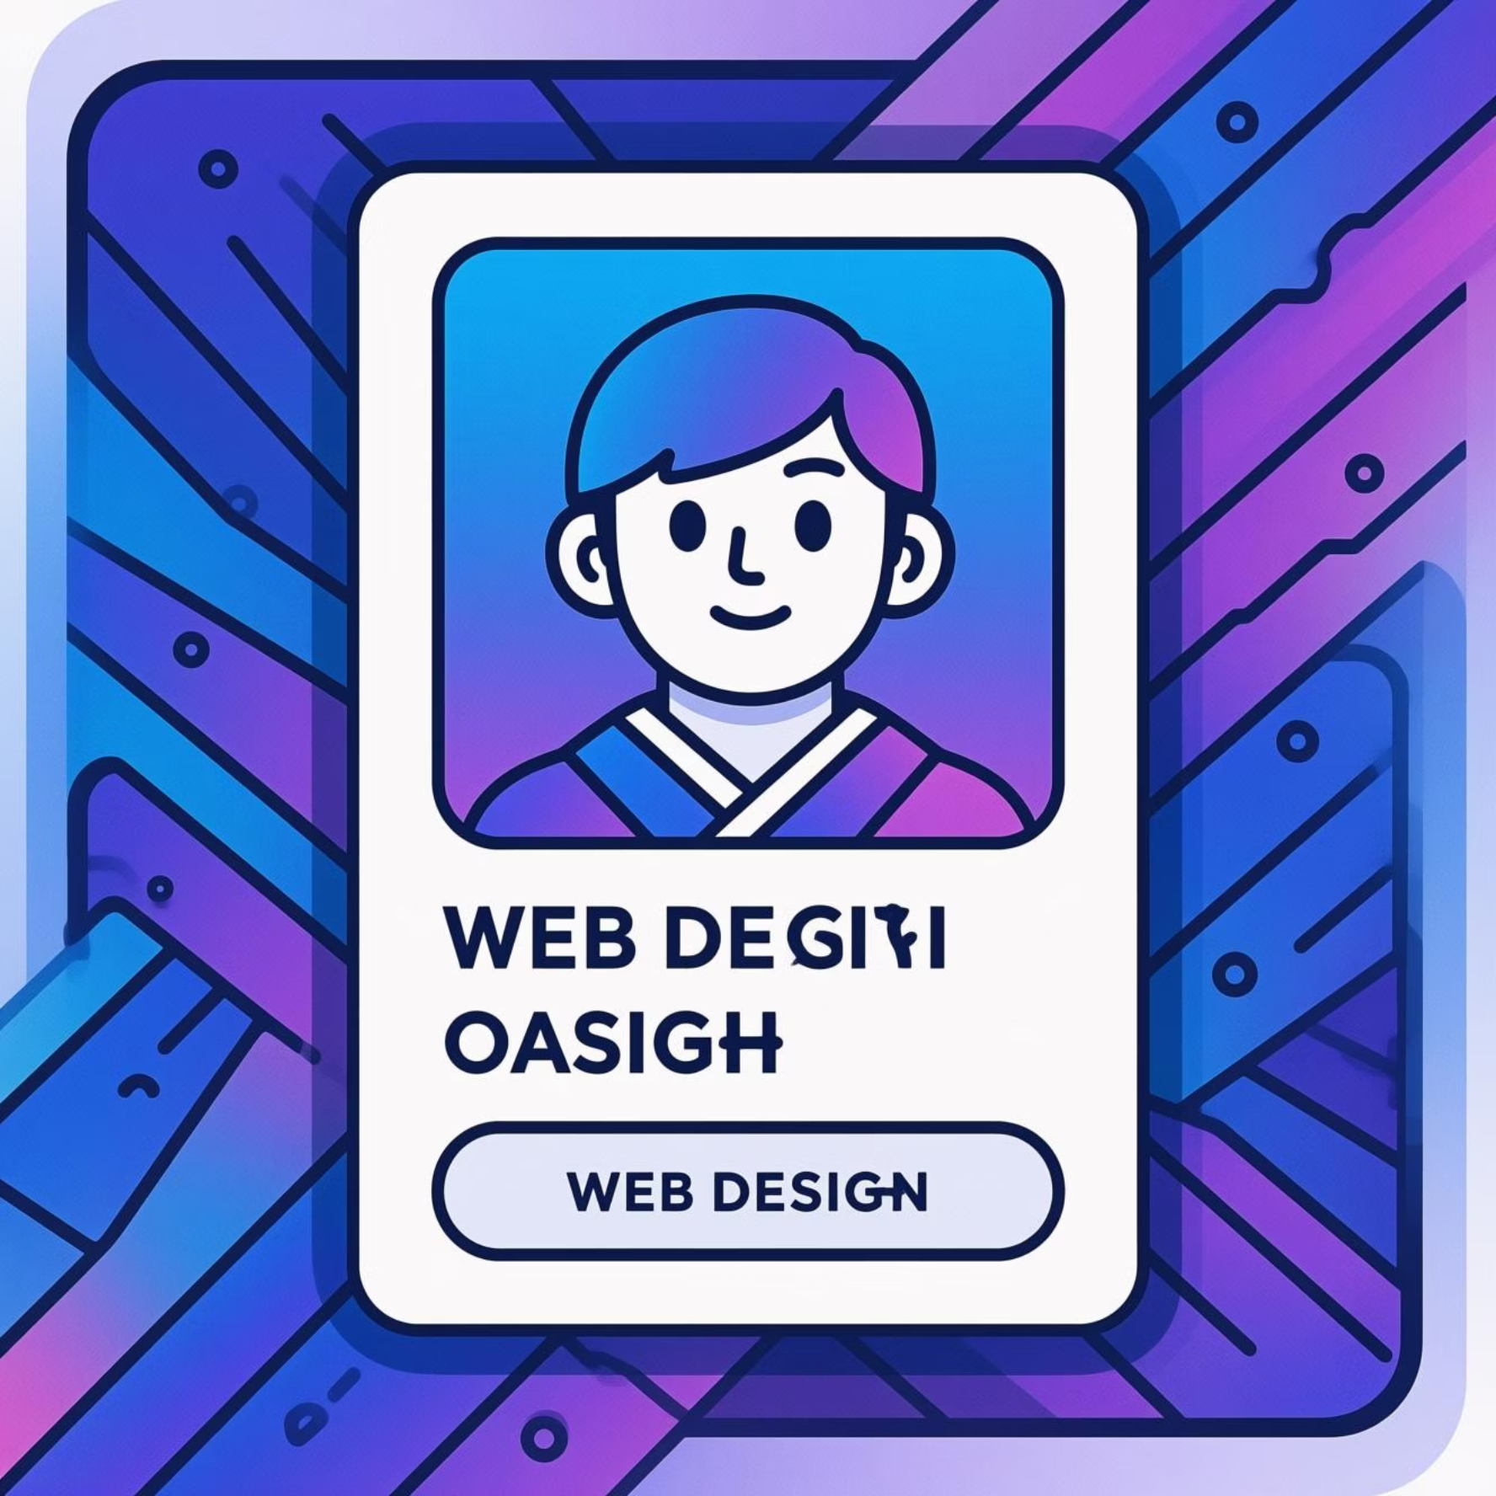
Practical Demonstration
Create a card component in just a few lines
Bulma Code
<div class="card"> <div class="card-image"> <figure class="image"> <img src="photo.jpg"> </figure> </div> <div class="card-content"> <p class="title is-4"> Titre du contenu </p> <p class="subtitle is-6"> Description </p> </div></div>
Instant Result
An elegant and responsive card without writing a single line of custom CSS. Bulma automatically handles responsiveness, spacing, and shadows.
✨ Before Bulma
🚀 After Bulma
Write 50+ lines of CSS to style a card, manually handle responsiveness, test on all screens.
5 minutes for a professional card, immediate responsiveness, cross-browser compatible, production-ready.

Slide 11



Conclusion
Bulma: Your Ally for Modern Interfaces
Lightweight Framework
Quick Learning
Only 200KB in minified version, optimal performance guaranteed
Intuitive class names, clear documentation, productive in just a few hours
Elegant Interfaces
Great Flexibility
Modern and professional design by default, infinitely customizable
Pure CSS without imposed JavaScript, integrates with any JS framework
Ready to transform your web projects?

Slide 12
THANKS !
HENINTSOA JORDI
RYAN SAM
MUCKAYA FLORIDA

